Slide 1
Gluconeogenesis

Slide 2
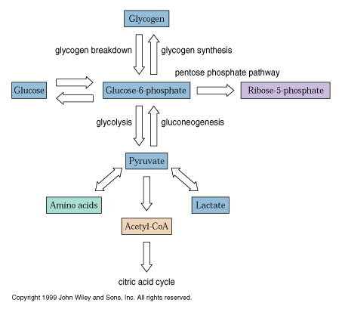
Overview of Glucose Metabolism

Slide 3
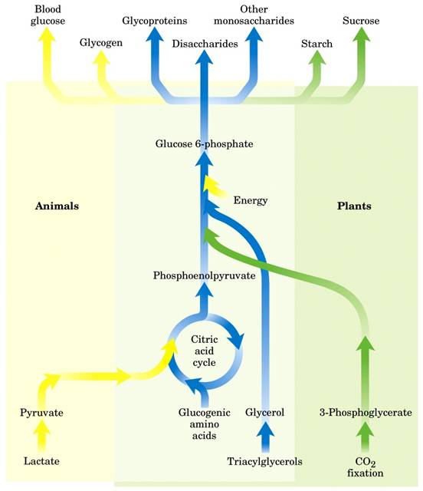
Gluconeogenesis
It is formation of glucose from
non-carbohydrates precursors.
- Occurs in all animals, plants and
microorganisms (universal pathway).
Essential in mammals because
nerve cells, testes, medulla
and RBCs require glucose
from blood as their major fuel source
Important precursors of the
glucose: lactate, pyruvate,
glycerol and back bone of
certain amino acids
Fasting requires all the glucose
to be synthesized from these
non-carbohydrate precursors.

Slide 4
Gluconeogenesis occurs largely in the liver, kidney, to little extent in
renal cortex and intestine under certain condition.
It occurs mostly in the cytosol, some reactions in the mitochondria
and the last step occurs within the endoplasmic reticulum cisternae.
It dose not occur by simple reversal of glycolysis.
Most precursors must enter the TCA cycle at some point to be
converted to oxaloacetate.
Oxaloacetate is the starting material for gluconeogenesis.
Seven of the of the glycolytic reactions are reversible and used in the
gluconeogenesis but three of them are irreversible and should be
bypassed by other four reactions.

Slide 5
The three steps which should be bypassed in gluconeogenic pathway:
1- Pyruvate to PEP
2- Fructose 1,6- bisphosphate to fructose-6-phosphate
3- Glucose-6-Phosphate to glucose
Conversion of pyruvate to PEP requires two exergonic reactions
mediated by the formation of oxaloacetate.
1- Pyruvate carboxylase requiring biotin as a cofactor, catalyses the
irreversible ATP-driven formation of oxaloacetate from pyruvate and
CO₂.
This enzyme found in the mitochondria of the liver and kidney but
not of muscle.
2- PEP carboxykinase converts oxaloacetate to PEP that uses GTP as a
phosphorylating agent.

Slide 6
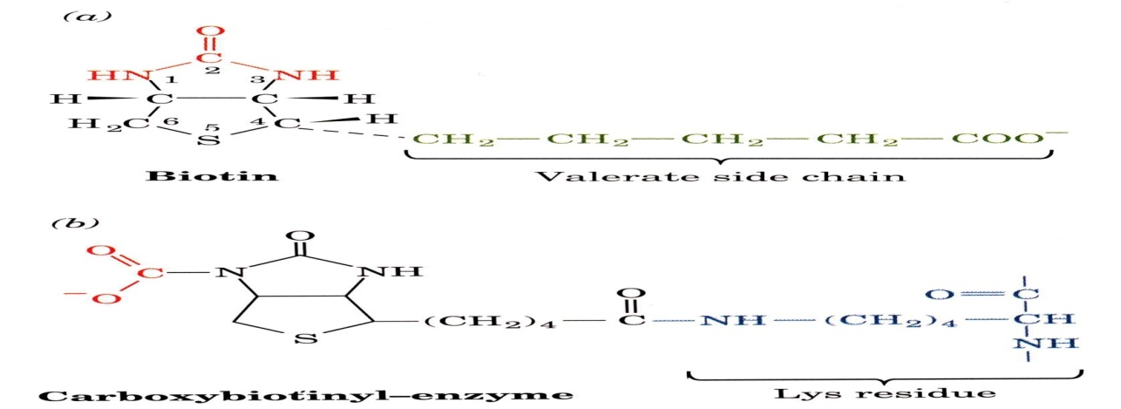
3- Hydrolysis of fructose-1,6-phosphate by fructose1,6-bisphosphatase
bypasses the irreversible PFK-1 reaction.
This reaction is an important regulatory step in gluconeogenesis and it
occurs only in the liver and kidney.
This enzyme is inhibited by high level of AMP which is a signal of an
energy-poor state in the cell, while high ATP stimulates
gluconeogenesis.
It is inhibited also by fructose 2,6-bisphosphate which is an
allosteric modulator, its level is affected by the circulating glucagon.

Slide 7
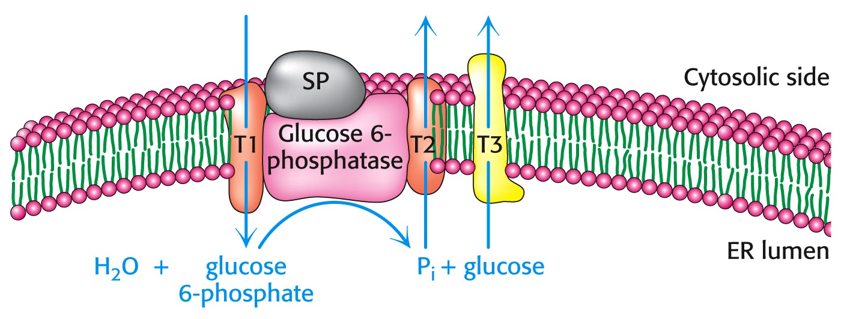
4- Hydrolysis of glucose-6-phosphate by glucose-6-phosphatase
bypasses the irreversible hexokinase reaction.
Glucose-6-phosphatase is only found in the liver to buffer blood
glucose levels and the kidney but not in the muscle and brain.
- Ca²⁺-binding stabilizing protein is essential for phosphatase activity.
Glucose and P_{i} are then shuttled back to the cytosol by transporters.
Generation of glucose from glucose 6-phosphate is involving several
proteins: SP – Ca-binding protein.
T1 transports G-6-P into the lumen of the ER
T2 and T3 transport Pi and glucose, respectively back into the cytosol.

Slide 8
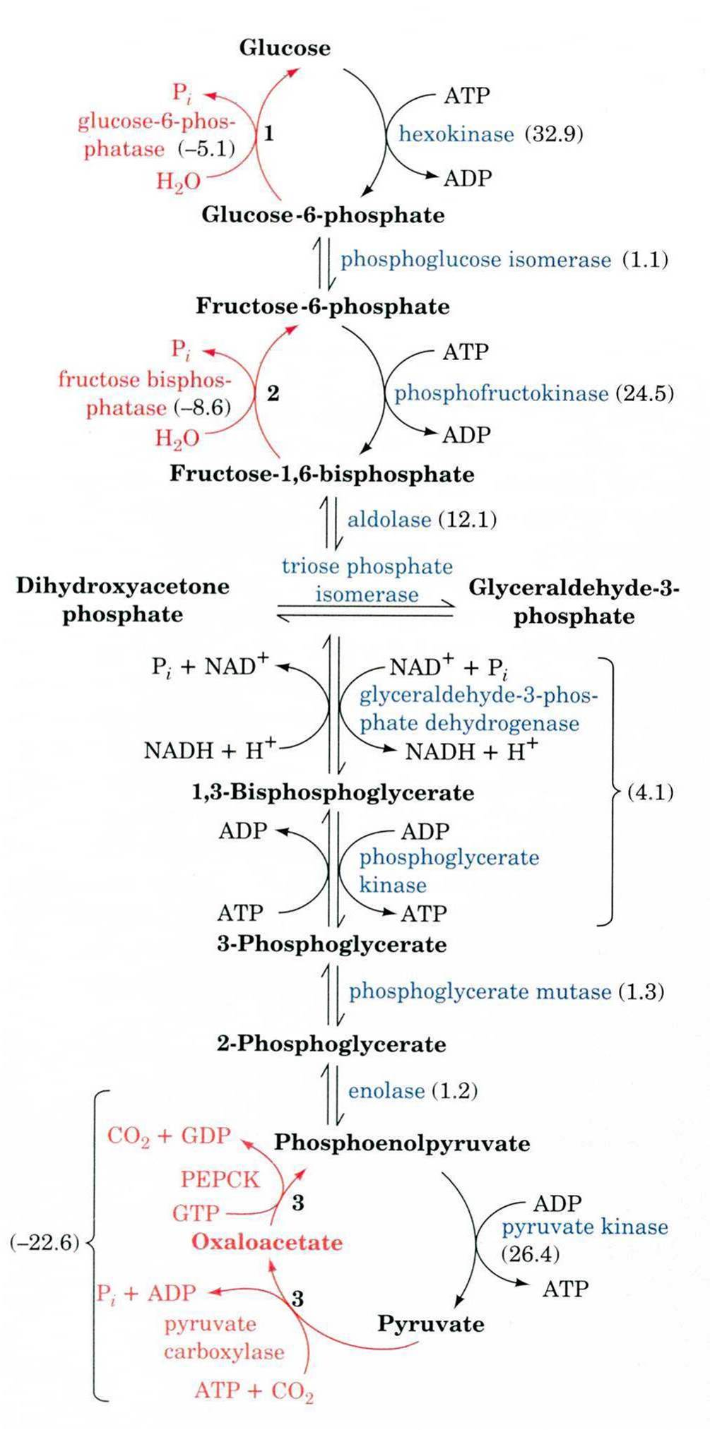
Gluconeogenesis
The overall reactions of
gluconeogenesis are:
2 Pyruvate +2 NAD + 4 H⁺
+ 4 ATP + 2 GTP + 6 H₂O
Glucose + 2 NAD⁺ + 4 ADP
+ 2 GDP + 4 Pi

Slide 9
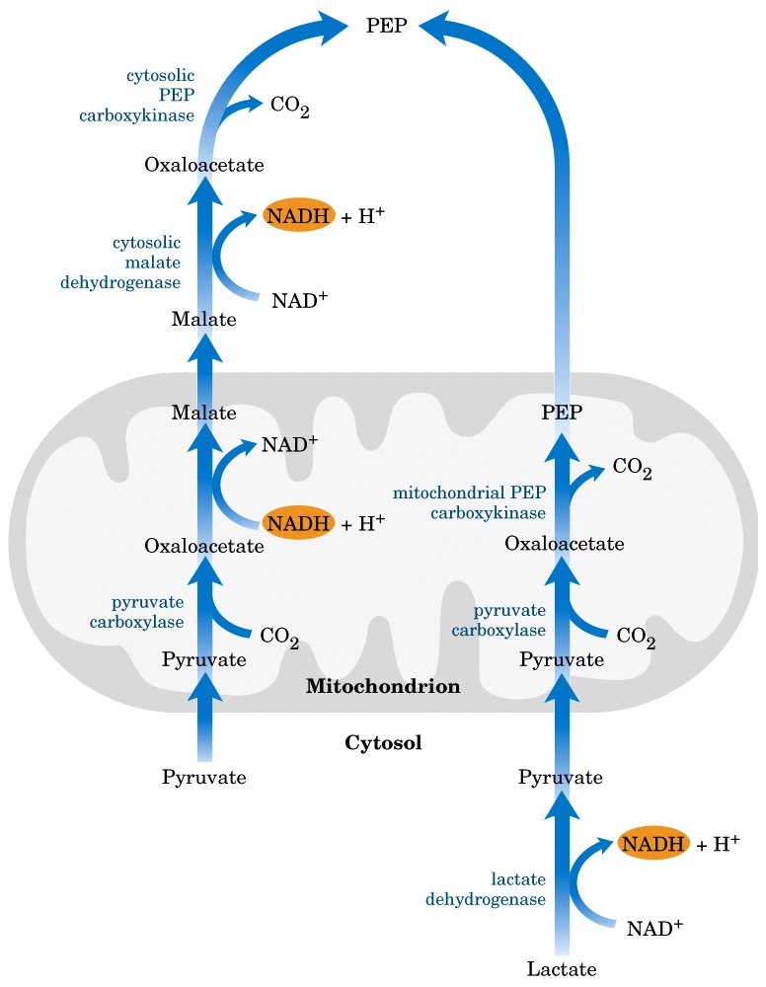
Transport between the mitochondria and the cytosol
Generation of oxaloacetate
occurs in the mitochondria only,
but, gluconeogenesis occurs in
the cytosol.
PEPCK is distributed between
both compartments in humans,
Either PEP must be transported
across the membranes or
oxaloacetate has to be
transported.
PEP transport systems are seen in
the mitochondria but oxaloacetate
can not be transported directly in
or out of the mitochondria.
It can transported out of the
mitochondria in form of Malate

Slide 10
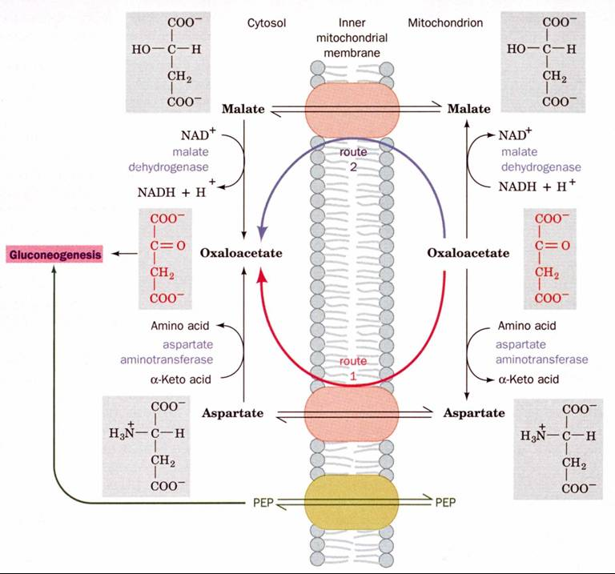

Slide 11
Regulation of gluconeogenesis
To prevent the waste of a futile cycle, glycolysis and gluconeogenesis
are reciprocally regulated.
F-1,6-bisphosphatase is the most important control site in
gluconeogenesis.
Reciprocal regulation by ATP/AMP
AMP inhibits fructose-1,6-bisphosphatase but activates PFK-1
ATP and citrate inhibit PFK-1 but activate fructose-1,6-biphosphatase
- In high ATP/AMP ratio: stimulate gluconeogenesis
- In low ATP/AMP ratio: stimulate glycolysis
- High levels of ATP and alanine, which signal that the energy charge is
high and that building blocks are abundant, inhibit pyruvate kinase.
- Pyruvate carboxylase is activated by acetyl CoA.
- ADP inhibits PEP carboxykinase and pyruvate carboxylase.

Slide 12
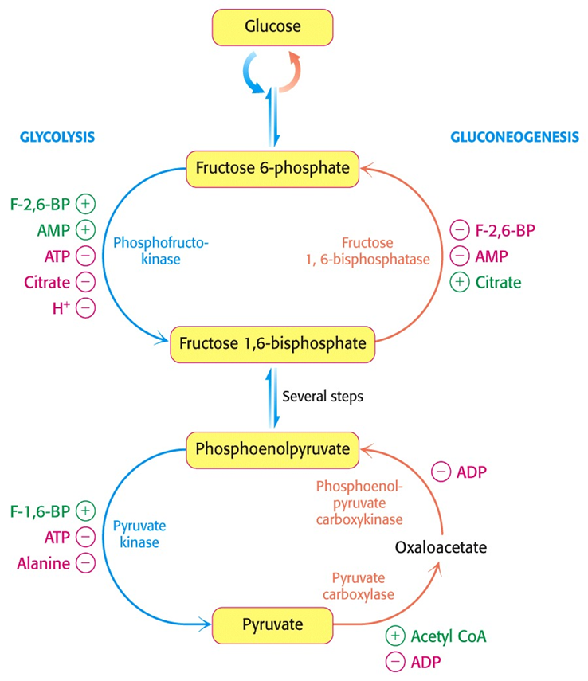
- Gluconeogenesis is favored when the cell is rich in biosynthetic
precursors and ATP.
Reciprocal regulation by fructose-2,6-biphosphate:
- Fructose-2,6-biphosphate stimulates glycolysis by activating PFK-1
and inhibits gluconeogenesis through the
inhibition of fructose-1,6-biphosphatase.
- During starvation, gluconeogenesis predominates because the level of
F-2,6-BP is very low.
Reciprocal regulation by hormones
PFK-1: induced in feeding by insulin and
repressed in starvation by glucagon
Fructose-1,6-bisphosphase: repressed in
feeding by insulin and induced in
starvation by glucagon
So: Insulin activates glycolysis but inhibits
gluconeogenesis; Glucagon activates
gluconeogenesis but inhibits glycolysis.

Slide 13
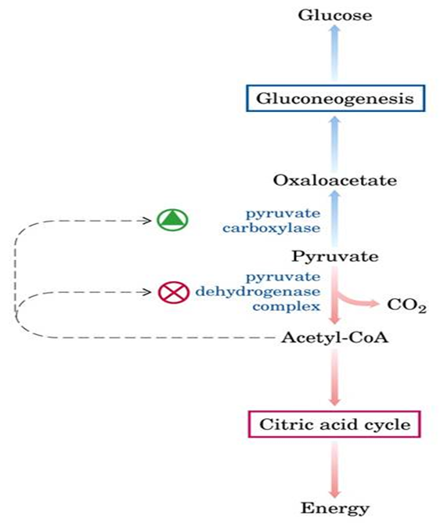
Acetyl-CoA regulates pyruvate carboxylase
- The increase in oxaloacetate concentration
→ the activity of the TCA cycle.
- Acetyl-CoA is an allosteric
activator of pyruvate carboxylase.
- At low levels of acetyl-CoA, pyruvate
carboxylase is largely inactive and
pyruvate is oxidized in TCA cycle.
- However, when ATP and NADH concentrations are high, TCA cycle is
increased, oxaloacetate goes to glucose.
Allosteric activation by acetyl CoA
- During starvation → excessive lipolysis → excessive oxidation of
fatty acid into acetyl CoA → accumulation of acetyl CoA → activation
of pyruvate carboxylase → activation of gluconeogenesis.

Slide 14
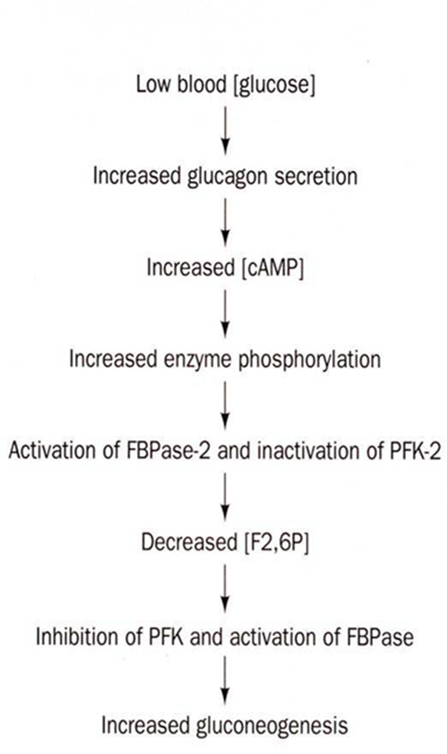
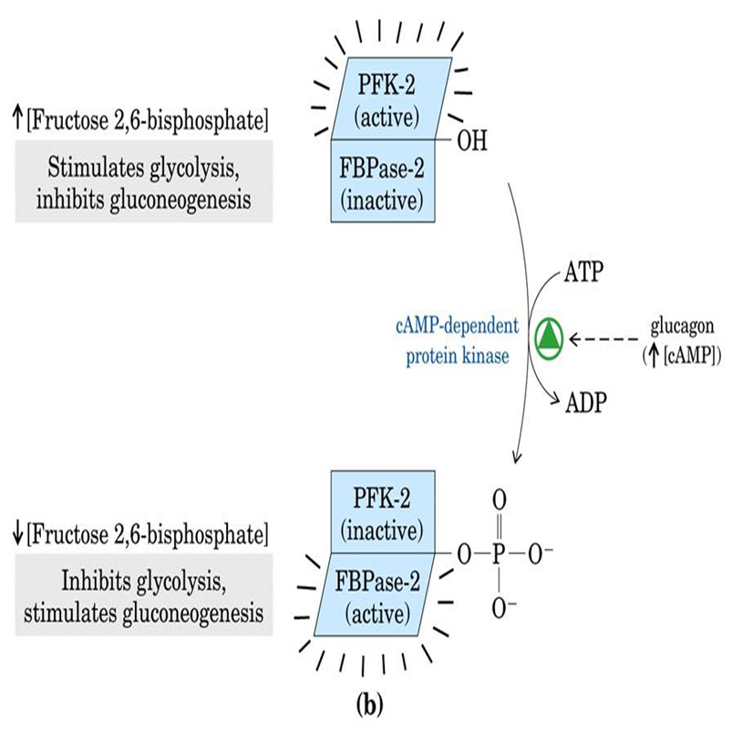
Substrate availability:
- The availability of gluconeogenic precursors like glucogenic amino
acids → ↑ the hepatic gluconeogenesis.
- ↓ Insulin / glucagon ratio favor the mobilization of amino acids from
muscle protein to provide their skeletons for gluconeogenesis.

Slide 15
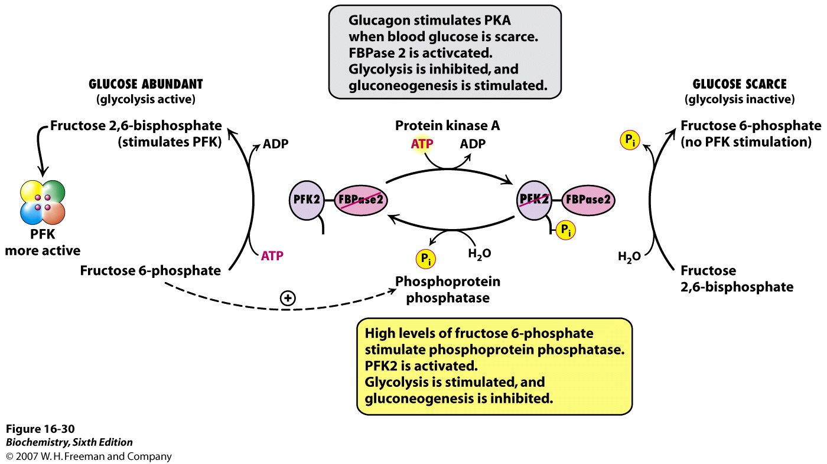
PEP carboxykinase ↑
F 1,6-bisphosphatase ↑
Glycolytic enzymes ↓
(pyruvate kinase)

Slide 16
Hormones
- Affect the expression of the gene of the essential enzymes
– Change the rate of transcription
– Regulate the degradation of mRNA
Phosphorylation control (~ s); allosteric control (~ms); transcription
control (~ h to d)
The promoter of the PEP carboxykinase (OAA→PEP) gene:
IRE: insulin response element;
GRE: glucocorticoid response element
TRE: thyroid response element
CREI and II: cAMP response elements

Slide 17
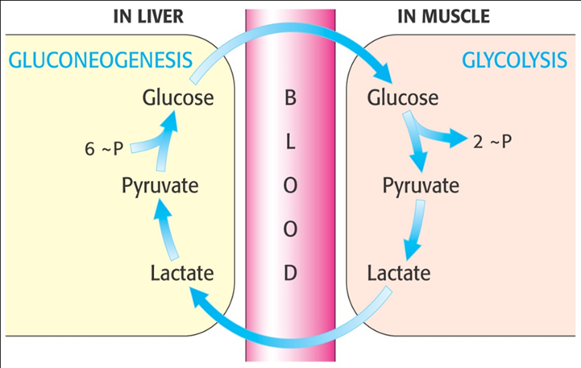
Substrates for gluconeogenesis
Include all intermediates of glycolysis and TCA cycle, glycerol, lactate
and the α-keto acids obtained from deamination of glucogenic A.A.s.
Glycerol: obtained from the hydrolysis of the triglycerides in adipose
tissue, travels to liver which is phosphorylated and metabolized.
- DHAP is converted into glyceraldehyde 3-P by triose isomerase.
- Lactate: released from the RBC and
exercising muscle, carried to the
liver by the blood and converted to
glucose and released again to blood
through Cori cycle.

Slide 18
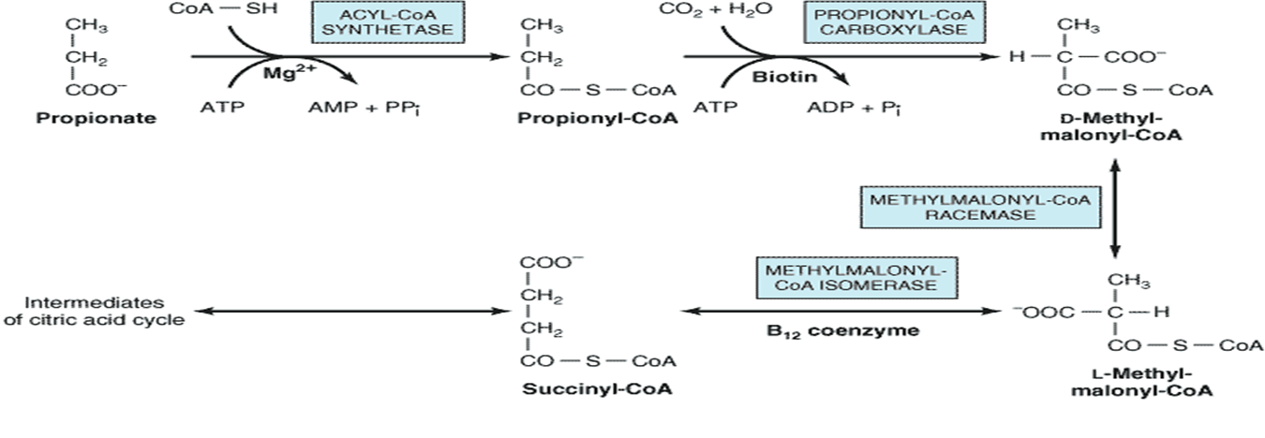
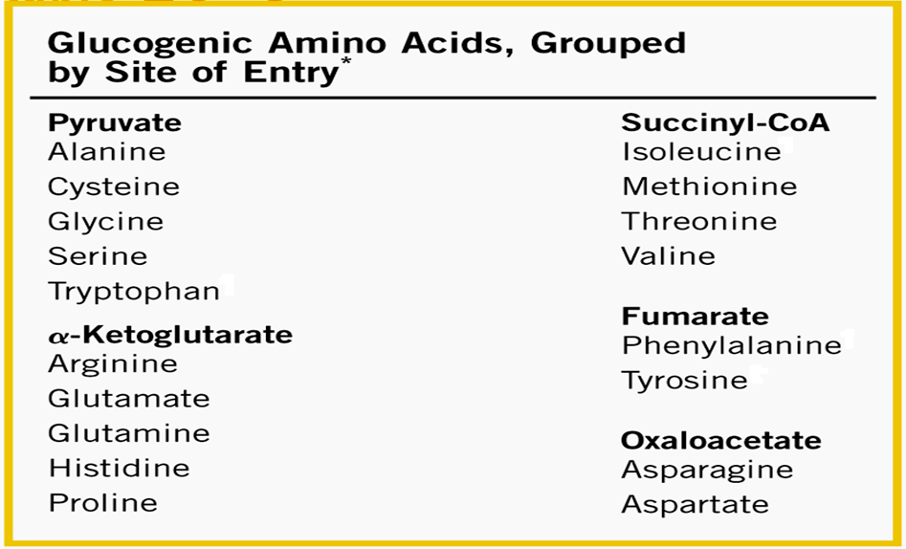
- Odd chain fatty acids: upon oxidation → propionyl CoA to be
converted into succinyl CoA to join TCA cycle.
- α-keto acids: like pyruvate and
α-ketoglutarate derived from amino
acids alanine and glutamate.
These substances enter TCA
cycle to provide the oxaloacetate.
- All amino acids can feed into
gluconeogenesis except
leucine and lysine.

Slide 19
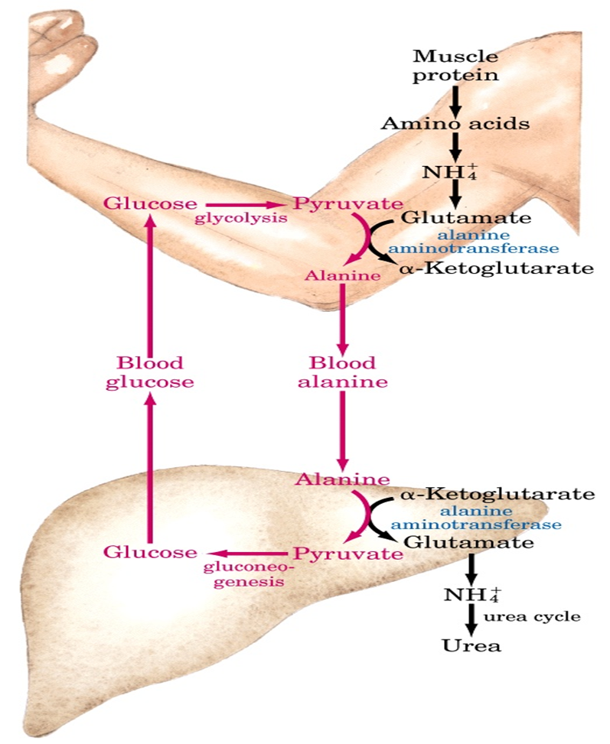
- Acetyl CoA cannot give rise to a net synthesis of glucose because of
the irreversible nature of PDH that converts pyruvate to acetyl CoA.
The Alanine cycle
- The liver can also use the amino
acid alanine similarly to lactate
- Following transamination to
pyruvate, gluconeogenesis allows
the liver to convert it to glucose
for secretion into the blood

